Slide 1
Optimizing Flocculation Systems
Alyssa Kirsch, Ken Rivero-Rivera, Jillian Whiting

Slide 2
Project Overview
Create optimized hydraulic flocculation algorithm to incorporate into aide_design
Translated existing MathCAD code to Python
Eliminated unnecessary code
Incorporated H/S ratio and energy dissipation

Slide 3
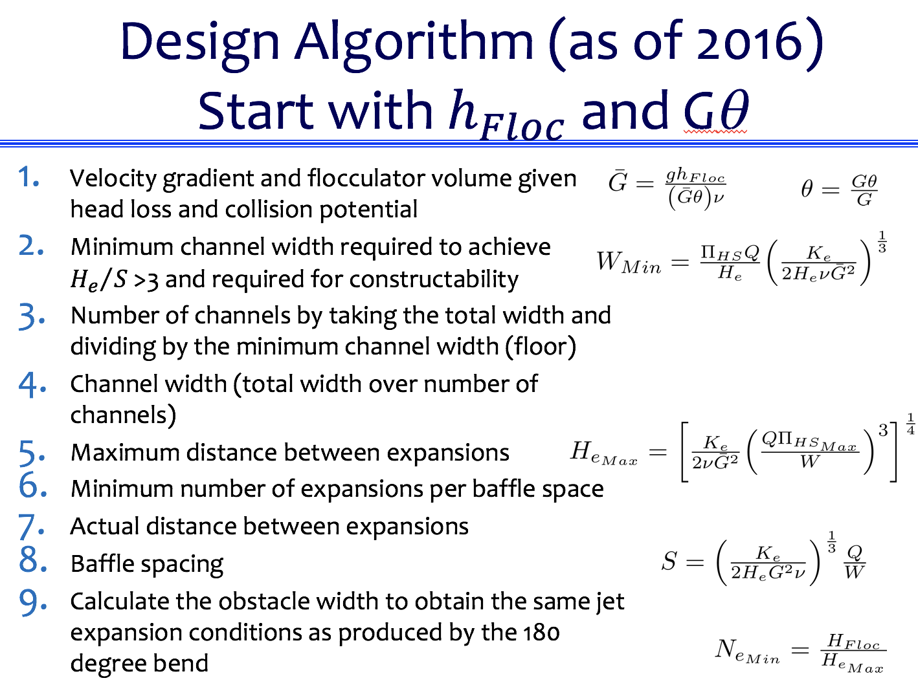
Notes:
Source: Weber Shirk, Monroe Flocculator Design Slides

Slide 4
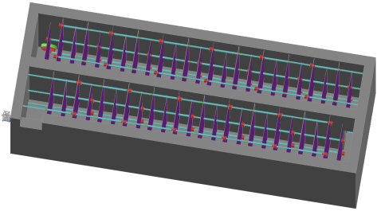
Inputs
Headloss = 40 cm
Flow Rate = 50 L/s
Wall Thickness = 15 cm
Collision Potential Goal = 37000
Length of the entrance tank = 1 m
Length of flocculator = 6 m
Width of Sed Tank channel = 30 cm

Slide 5
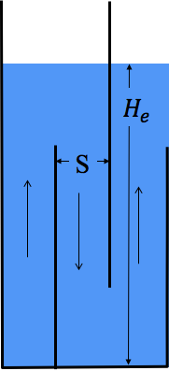
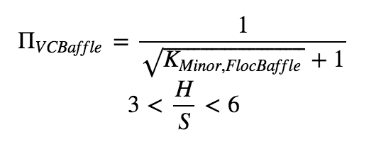
Step 1: Flocculator Efficiency

Slide 6
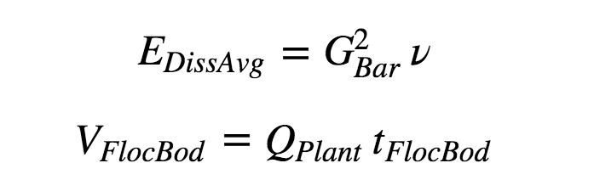
Step 2: Volume Constraint - Energy Dissipation with max headloss

Slide 7
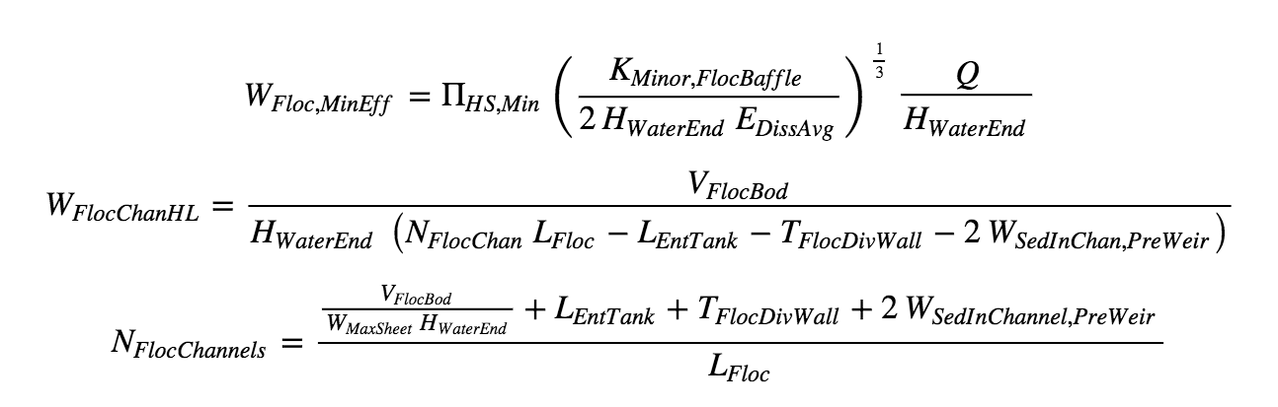
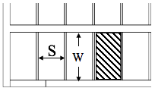
Step 3: Channel Width and Number of Channels

Slide 8
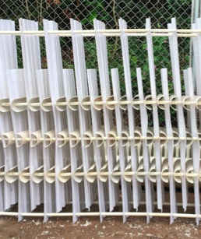
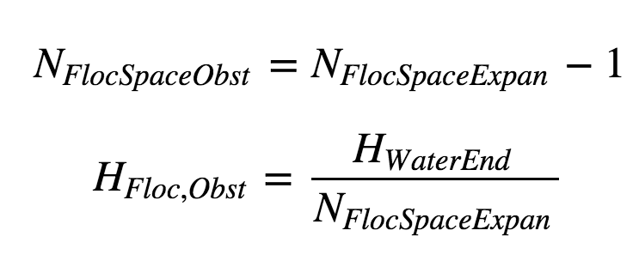
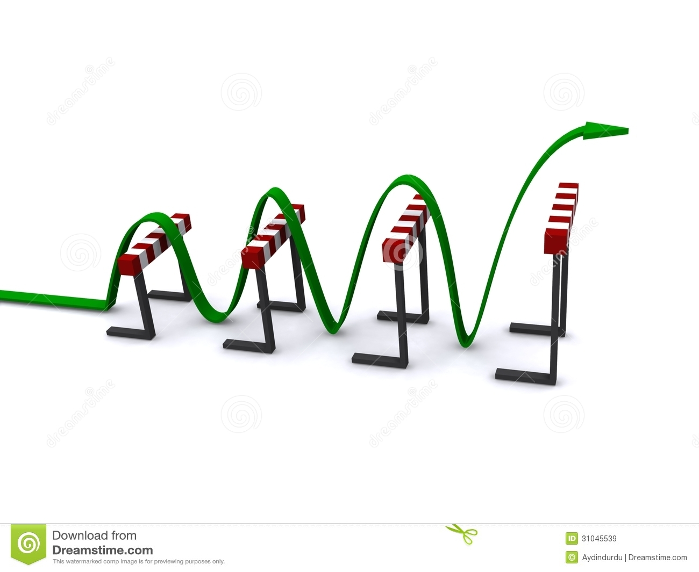
Step 4: Obstacles

Slide 9

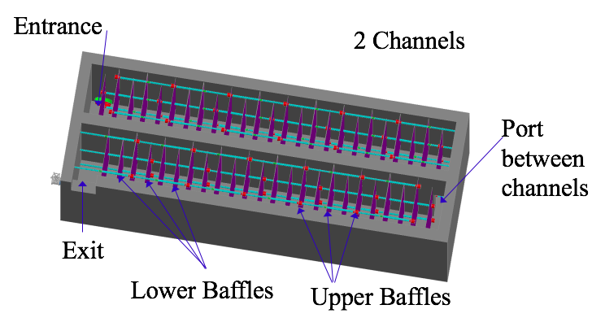
Step 5: Baffle Spacing

Slide 10
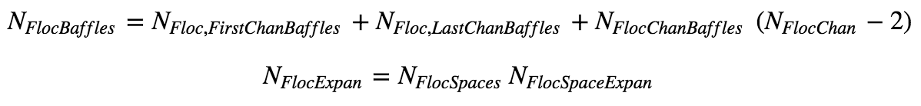
Step 6: Number of baffles and expansions

Slide 11
Final Parameters

Slide 12
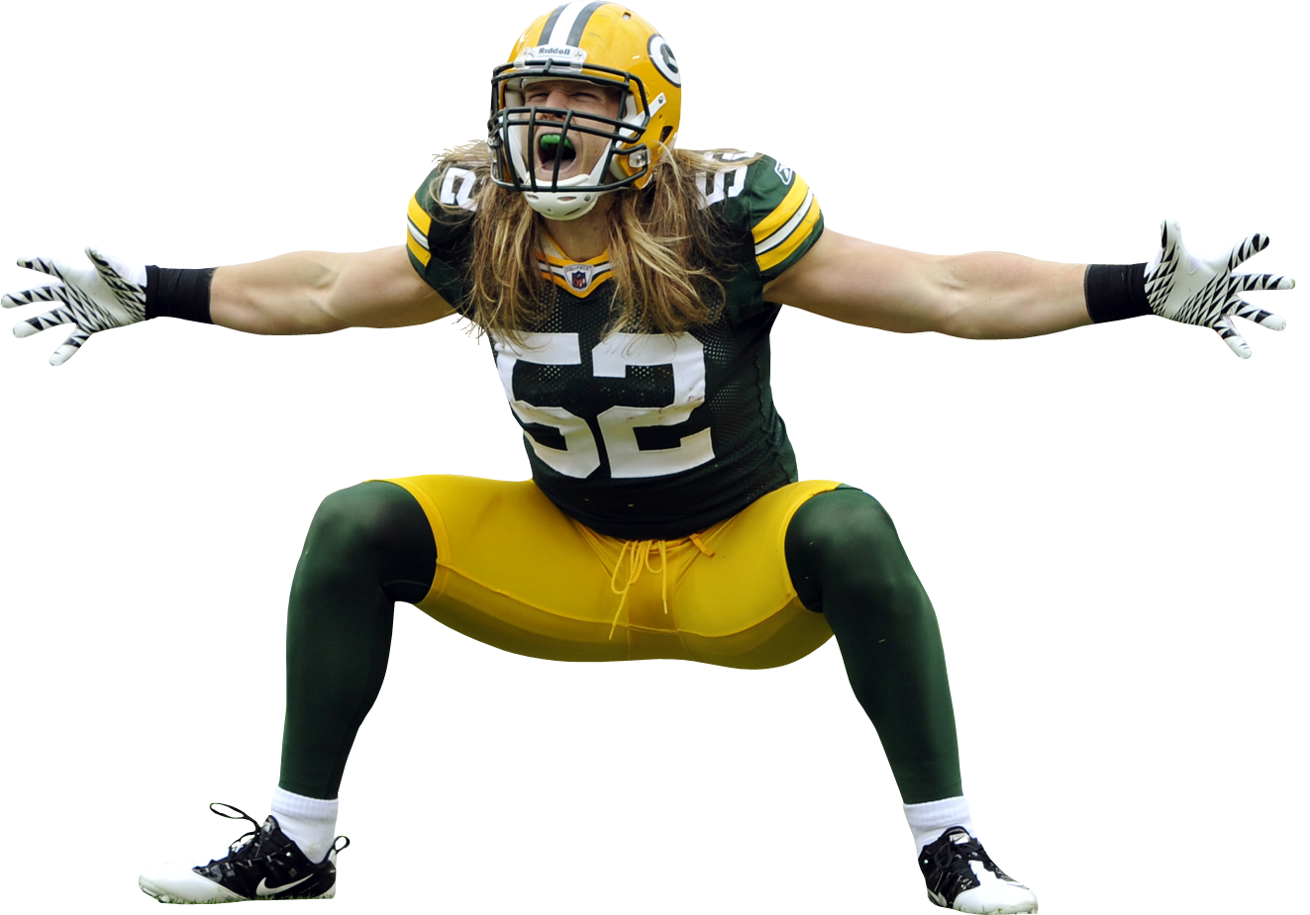
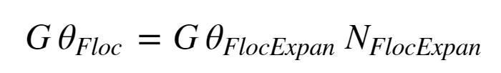
Collision Potential
= 38531

Slide 13
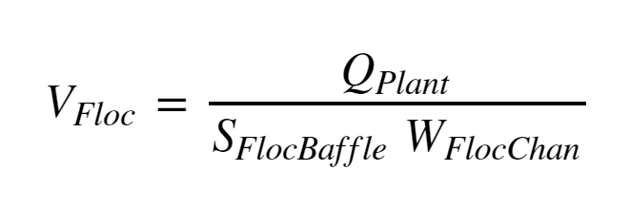
Fluid Velocity
= 217 mm/s

Slide 14
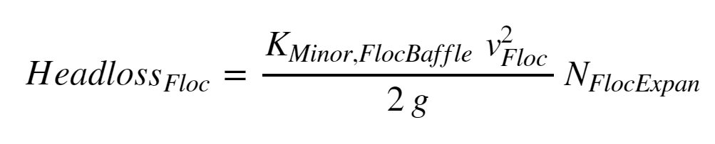
Headloss
= 443.7 mm

Slide 15
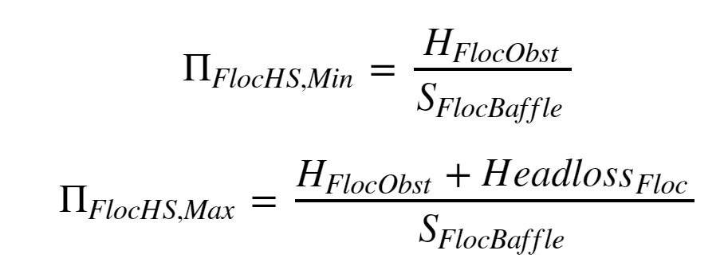
H/S Ratio
= Min: 3.693, Max: 5.331

Slide 16
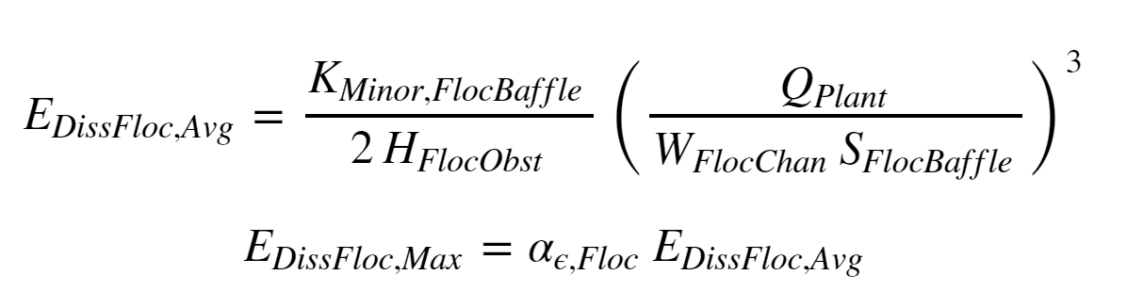

Energy Dissipation Rate
= 25.51 mW/kg

Slide 17
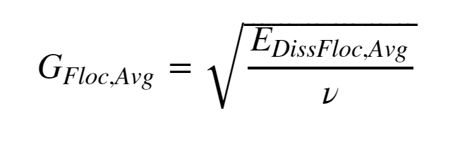
Average Velocity Gradient
= 112.9 Hz

Slide 18
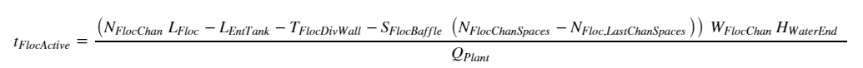
Active Residence Time
= 351.0 sec

Slide 19
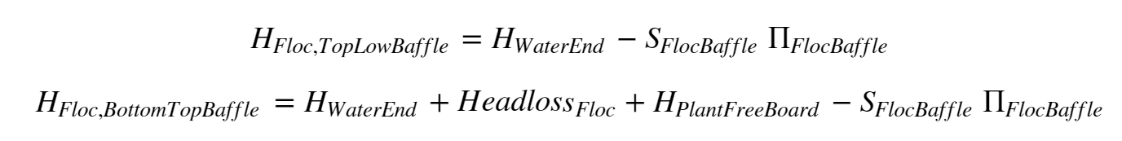
Baffle Heights
= 1.729 m and 2.273 m

Slide 20
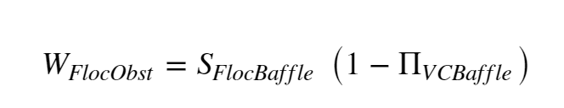
Obstacle Width
= 165.9 mm

Slide 21
Thank you

Slide 22
Bibliography
Weber-Shirk, Monroe (2017). Flocculator Design [PowerPoint Slides] https://confluence.cornell.edu/display/cee4540/Syllabus
Weber-Shirk, Monroe (2017). Flocculator Model [PowerPoint Slides] https://confluence.cornell.edu/display/cee4540/Syllabus

